Slide 1
Diversify Your Syllabi:
South Asian Philosophy
Prof. Charles Goodman
Binghamton University (SUNY)
To be presented at York University, 2/28/19

Slide 2
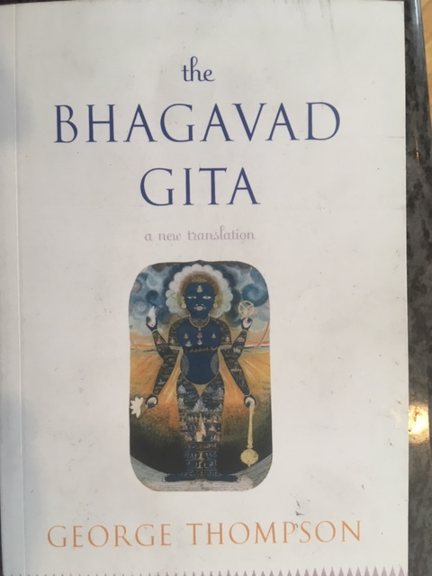

Slide 3
The Bhagavad Gita,
George Thompson, trans.
Single most important sacred scripture of contemporary Hinduism
Presents a deontological ethic that represents a radical alternative to standard conceptions of instrumental rationality
Contains arguments, but many premises are based on divine authority. Questionable whether it should count as philosophy

Slide 4
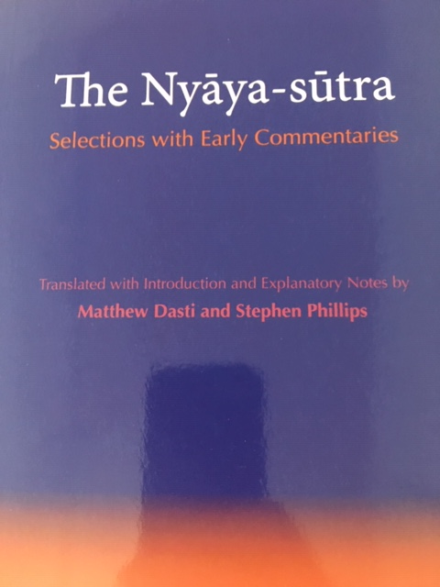

Slide 5
The Nyāya-Sūtra,
M. Dasti and S. Phillips, trans.
Use for classes on metaphysics, epistemology, philosophy of religion
Shows the early development of epistemology in India
A realist tradition opposed to prevalent idealist views in Hinduism and highly critical of Buddhist thought
Extensive translations of commentarial material make verses much more accessible

Slide 6
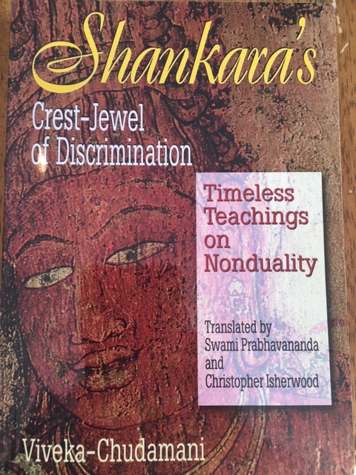

Slide 7
Shankara’s Crest-Jewel of Discrimination,
Prabhavananda and Isherwood, trans.
Short, accessible introduction to Advaita Vedānta, the most influential philosophical tradition in contemporary Hinduism
I teach pp. 52-76 for challenging arguments about personal identity and rejection of a real external world

Slide 8
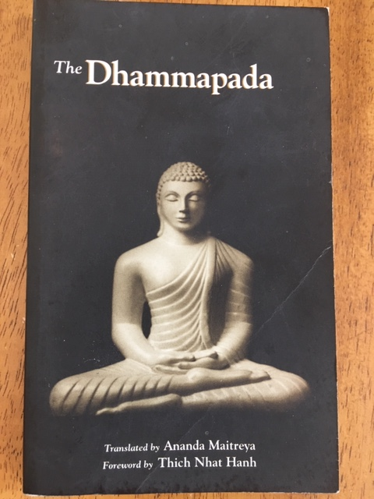

Slide 9
The Dhammapada,
Ānanda Maitreya, trans.
Most popular Buddhist scripture in contemporary Southeast Asia
Use as an introduction to basic Buddhist values and beliefs
Short enough to teach the whole thing, but assign especially ch. 1-2 and 10
Byrom translation also available. More beautiful but less accurate

Slide 10
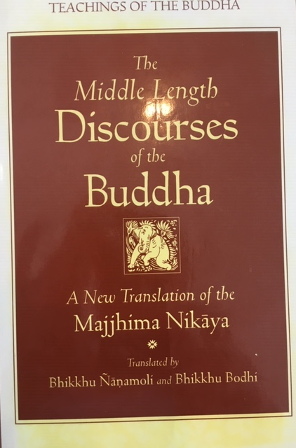

Slide 11
The Middle Length Discourses of the Buddha. Ñānamoli and Bodhi, trans.
Especially useful for classes:
The Noble Search, MN 26: The historical Buddha’s life story
The Shorter Discourse to Saccaka, MN 35: Personal identity
Māgandiya Sutta, MN 75: Theory of well-being
The Simile of the Snake, MN 22: Uses and limits of philosophy, pragmatism. Also MN 63 and 72

Slide 12
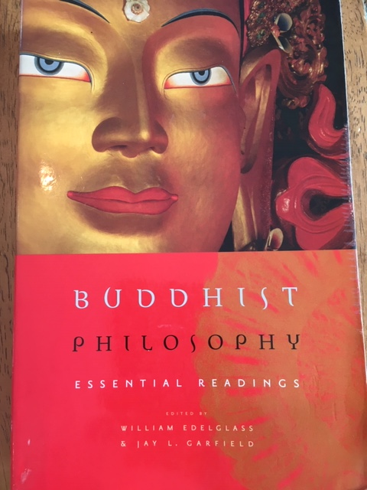

Slide 13
Buddhist Philosophy: Essential Readings
W. Edelglass and J. Garfield, eds.
Very wide selection of readings from South, Central, and East Asian Buddhist traditions
For the Buddhist view on personal identity, assign especially ch. 23, 25, 26 and 28
Don’t teach the whole book! Many Tibetan readings require extensive background in Buddhist thought; many E. Asian readings are opaque. Might try Dōgen, though

Slide 14
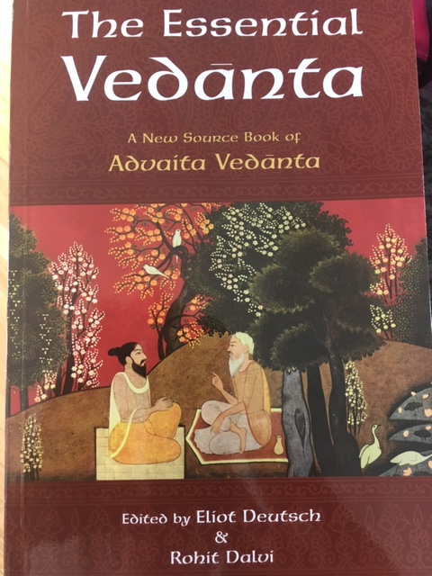

Slide 15
The Essential Vedānta,
E. Deutsch and R. Dalvi, ed. and trans.
Broad range of primary sources from the entire history of the Vedānta tradition
Of greatest philosophical interest is ch. 6, “Criticisms of Rival Systems”, containing material that can be used as a counterpoint to Buddhist reductionism about personal identity, as well as many other topics

Slide 16
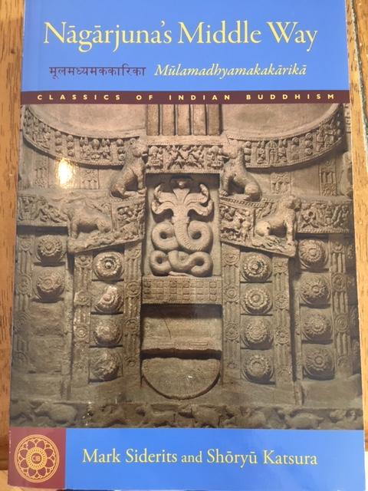

Slide 17
Nāgārjuna’s Middle Way,
Siderits and Katsura, trans.
Why to use:
Single most influential and important work of Buddhist philosophy
Detailed explanatory notes, based on all four Indian commentaries, walk students through the arguments
Deeply scholarly, if not always elegant, translation

Slide 18
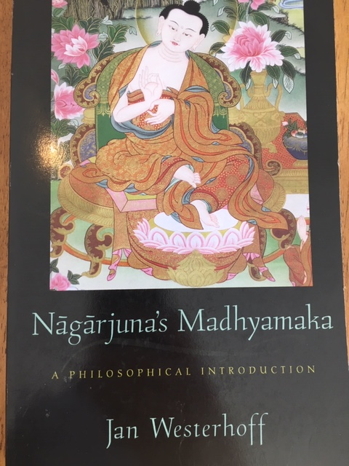

Slide 19
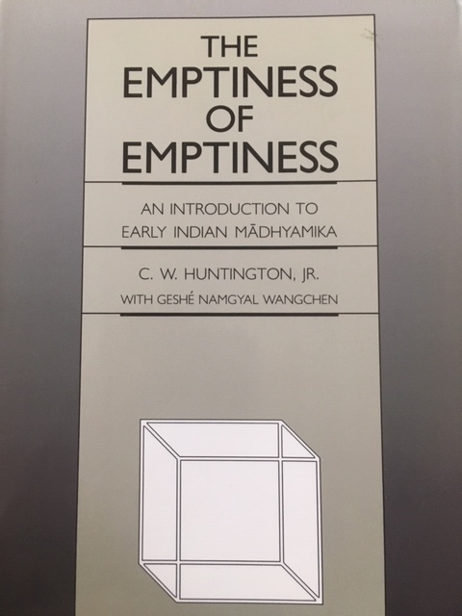

Slide 20
The Emptiness of Emptiness,
Huntington and Wangchen, trans.
A possible alternative to Nāgārjuna’s Middle Way. Offers fewer arguments but explains them more fully
Teach ch. 6 (which is most of the pages)
Extensive introductory material by Huntington offers a controversial but interesting interpretation of Madhyamaka that connects it directly to contemporary Western concerns

Slide 21
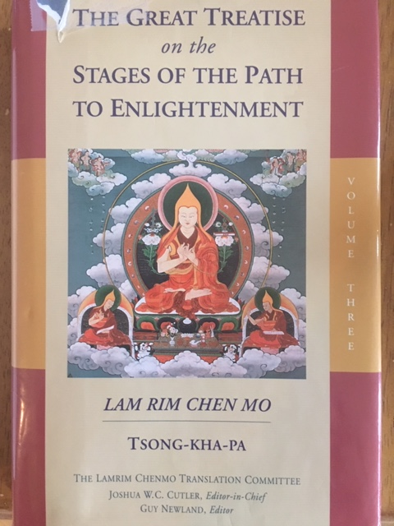

Slide 22
Tsong-kha-pa’s Great Treatise, vol. 3
Lamrim Chenmo Translation Committee
One of the most important works of Tibetan philosophy. A key text in the lineage of HHDL
Dense and technical, but somewhat less difficult than Tsong-kha-pa’s other main texts
Shows how to understand Nāgārjuna’s teachings as presenting a philosophical position

Slide 23
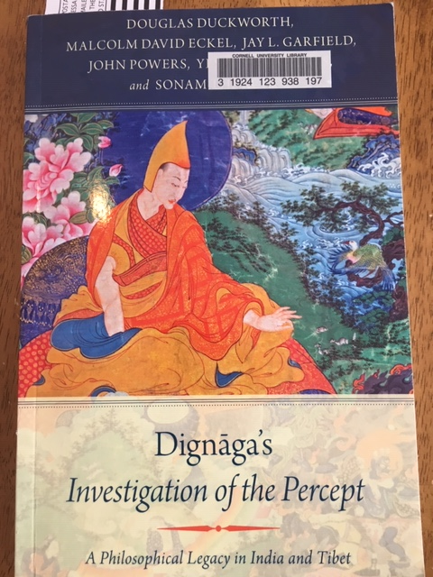

Slide 24
Dignāga’s Investigation of the Percept,
Duckworth et al., trans.
Short text on philosophy of perception
Requires familiarity with Buddhist mereological reductionism
Excellent way into discussion of idealism
Very extensive commentarial material, including translations of one Indian and several Tibetan commentaries

Slide 25
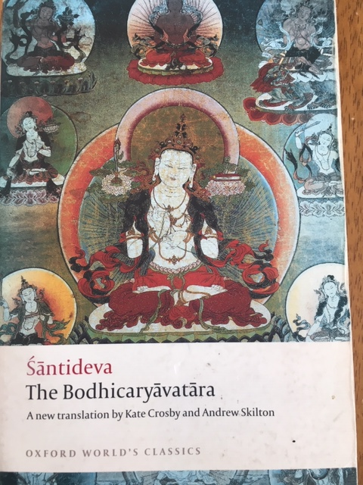

Slide 26
Śāntideva. The Bodhicaryāvatāra,
Crosby and Skilton, trans.
Single most important primary source for moral philosophy in Buddhism
Some of the finest Buddhist poetry ever written
Contains almost the only discussion of free will to be found in premodern South Asia
Assign especially ch. 6 and ch. 8. Avoid ch. 9
A Guide to the Bodhisattva Way of Life, trans. Wallace and Wallace, also available, and numerous other translations into modern languages

Slide 27
Readings of the Bodhicaryāvatāra,
J. Gold and D. Duckworth, eds.
Contains essays specifically designed to help philosophers with little previous knowledge of Buddhism understand and teach the BCA
Contributions from a wide range of highly regarded scholars
In press; should be available later this year

Slide 28
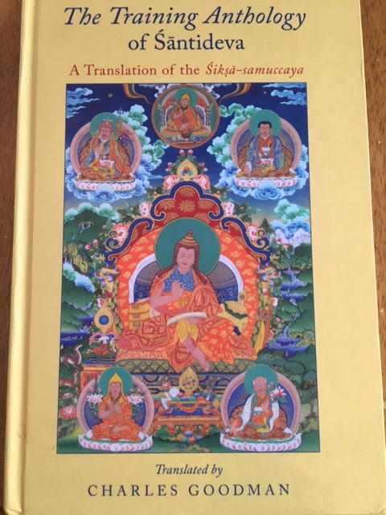

Slide 29
The Training Anthology of Śāntideva,
C. Goodman, trans.
May be the first clear articulation of utilitarianism in human history, working out a rich and unfamiliar conception of that view’s implications
Can be used to bring out the appeal of utilitarianism, and also objections against it, including demandingness and issues about special obligations
For ethics, teach especially ch. 1 and ch. 6-9
Use ch. 14 for a more accessible presentation of emptiness than can be found in Nāgārjuna

Slide 30
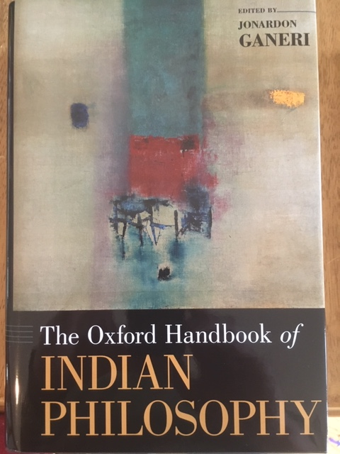

Slide 31
Oxford Handbook of Indian Philosophy, ed. Jonardon Ganeri
Up-to-date collection of high-quality articles on a wide range of authors from the whole history of Indian thought, including the British colonial period, up to independence
Use as a reference source, for background information on a given philosopher and to help you situate that figure in the long history of South Asian thought

Slide 32
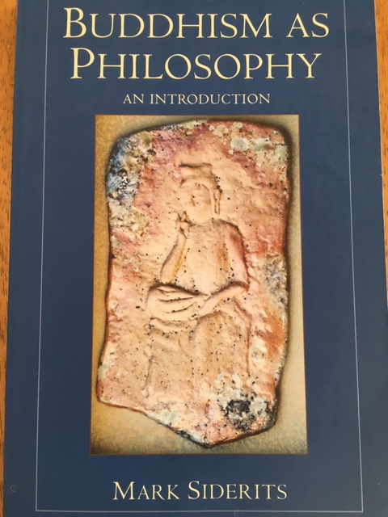

Slide 33
Mark Siderits,
Buddhism as Philosophy
Why to use:
Philosophically sophisticated general introduction
Shows how to read Buddhism as a philosophical tradition
Contains a translation of Vasubandhu’s Twenty Verses, a major work on Buddhist idealism

Slide 34
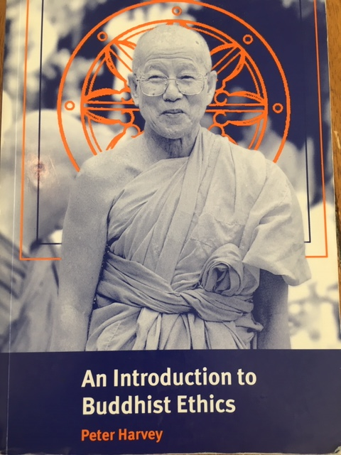

Slide 35
An Introduction to Buddhist Ethics,
Peter Harvey
Broad, thorough, systematic and scholarly coverage of Buddhist views on many normative questions
Several individual chapters that could be used in applied ethics classes
Offers anthropological information about cultural practices as well as textual insights
Sometimes lacks philosophical rigor

Slide 36
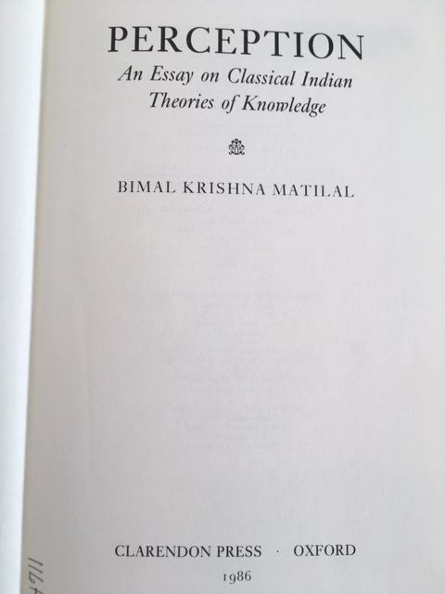

Slide 37
Perception,
B. Matilal
Regarded as a classic work of scholarship
Use as background reading or for advanced classes in epistemology, philosophy of mind, philosophy of perception
Very broad and deeply informed perspective on the full range of South Asian views on the topic

Slide 38


Slide 39
Artha: Meaning,
J. Ganeri
Dry, highly technical treatise on Indian philosophy of language
Demonstrates the sophistication attained by Indian philosophical linguistics, and especially by the “New Logic” (Navya-nyāya) tradition
Plausibly argues that Indian authors solved several specific problems about language that are still controversial in Western philosophy
Use in advanced courses on philosophy of language

Slide 40
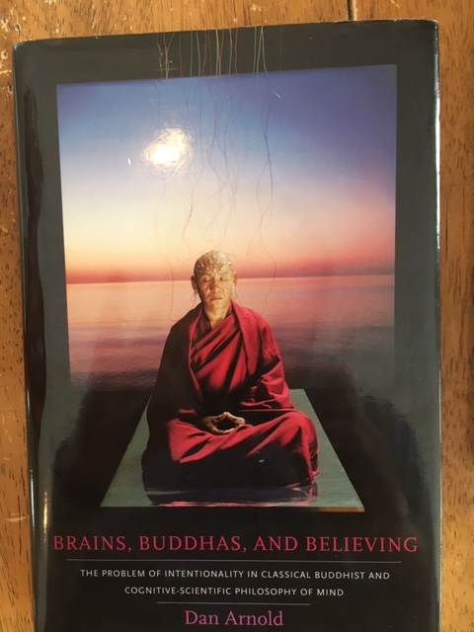

Slide 41
Brains, Buddhas, and Believing,
Dan Arnold
Use for courses on the philosophy of mind
Presents a sophisticated argument against certain kinds of reductionist philosophical trends influenced by cognitive science. Highly critical of parts of the Buddhist tradition
Also consider his first book, Buddhists, Brahmins and Belief, for similar themes and insights into Mīmāṃsā philosophy

Slide 42
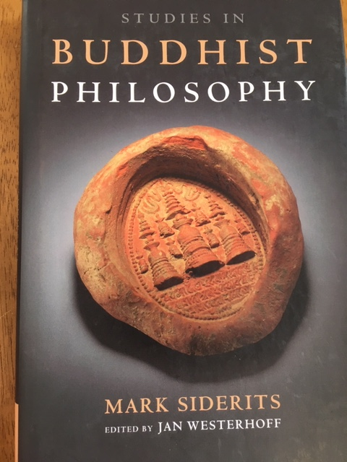

Slide 43
Studies in Buddhist Philosophy,
Mark Siderits
Use for upper-division classes in metaphysics, epistemology and philosophy of language
For epistemology, assign especially chapters 2.5, 4.1 and 4.3. 4.1, “The Madhyamaka Critique of Epistemology (I)”, is quite accessible to students and very valuable
For philosophy of language, especially 3.1 and 3.2

